Slide 1
Chapter 2: Process and Methodology

Slide 2
Key Takeaway Points
A software process defines the phases of activities or what need to be performed to construct a software system.
A software methodology details the steps or how to perform the activities of a software process. A methodology is an implementation of a process.
Software development needs a software process and a methodology.
2-<number>

Slide 3
Challenges of System Development
Project Reality 1. Many systems require many years to develop.
Project Challenge 1. How do we schedule, and manage the work without knowing exactly what the customer wants, and what may happen in the future?
Project Reality 2. Many software projects require collaboration of multiple departments and teams.
Project Challenge 2. How do we divide the work among the departments and teams, and integrate the components produced by them?
Project Reality 3. Different departments or teams may use different processes, methods, and tools. They may reside at different locations.
Project Challenge 3. How do we ensure proper communication and coordination among the departments and teams?
2-<number>

Slide 4
Challenges of Systems Development
System Reality 1. Many systems need to satisfy numerous requirements and constraints.
System Challenge 1. How do we develop systems to ensure that the requirements and constraints are met?
System Reality 2. Requirements and constraints may change from time to time.
System Challenge 2. How do we design the processes and the products to cope with change?
System Reality 3. A system may consist of hardware, software and third party components using different programming languages and run on multiple platforms and machines located at different places.
System Challenge 3. How do we design the system to hide these differences?
2-<number>

Slide 5
Software Process
System development challenges call for an engineering approach for software development. A software process is required.
Definition 2.1 A software process defines a series of activities performed to construct a software system. Each activity produces some artifacts, which are the input to other phases. Each phase has a set of entrance criteria and a set of exit criteria.
2-<number>

Slide 6
The Waterfall Process
System Engineering
Software Requirements Analysis
Software Design
Coding & Unit Testing
Integration & Integration Testing
Acceptance Testing
Maintenance
2-<number>

Slide 7
Merits of the Waterfall Model
The simple, straight sequence of phases of the waterfall simplifies project management.
It supports function-oriented project organization:
  Each project is carried out by a pipeline of functional teams.
  Each functional team is specialized in one function such as requirements analysis, design, implementation, integration and testing, and so forth.
2-<number>

Slide 8
Problems of the Waterfall Model
It is inflexible to requirements change.
The long development duration means the system is outdated when it is delivered.
Users cannot experiment with the system to provide early feedback.
The customer has to wait until the entire system is implemented and deployed to reap the benefits.
The customer may lose the entire investment if the project fails.
2-<number>

Slide 9
Software Process Models
Prototyping Process Model
Evolutionary Process Model
Spiral Process Model
Unified Process Model
Personal Software Process Model
Team Software Process Model
Agile Process Models
2-<number>

Slide 10
Prototyping Process Model
Prototypes of the software system are constructed to:
  acquire and validate requirements
  assess the feasibility of the project and/or the feasibility of the requirements and constraints
Simple prototypes as well as sophisticated prototypes are used, depending on the needs of the project.
Prototypes are classified into throwaway prototypes and evolutionary prototypes.
2-<number>

Slide 11
Evolutionary Prototyping Model
Throwaway prototypes waste time and effort.
Evolutionary prototyping model lets the prototype evolve into the production system.
It is most suited for the development of exploratory types of systems such as intelligent systems, research software, and systems that actively interact with and control the environment.
It is not suitable for projects that require a predictable schedule of progress.
2-<number>

Slide 12
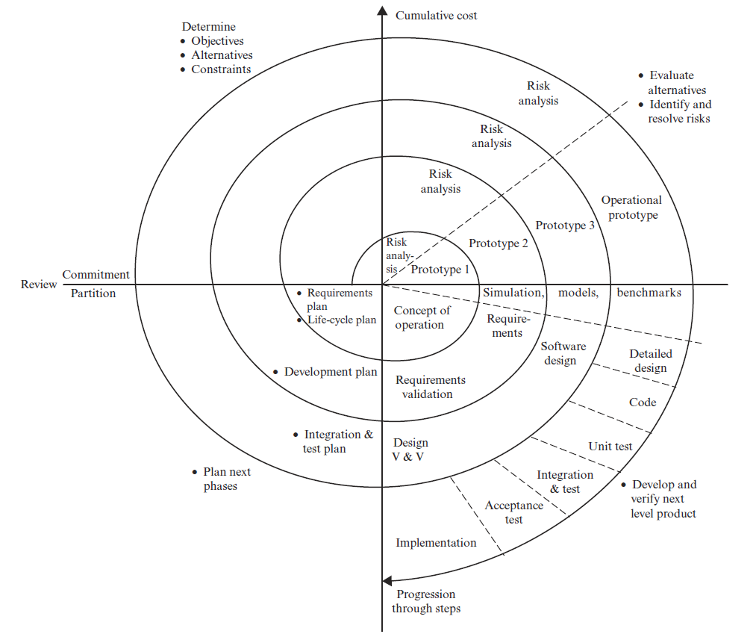

Spiral Process Model
If risks remains {
plan next phase (SW)
conduct prototyping }
else if risks resolved {
proceed as waterfall
(SE) }
else if prototype works
& robust {
proceed as
evolutionary model
(NE corner) }
It begins here.
2-<number>

Slide 13
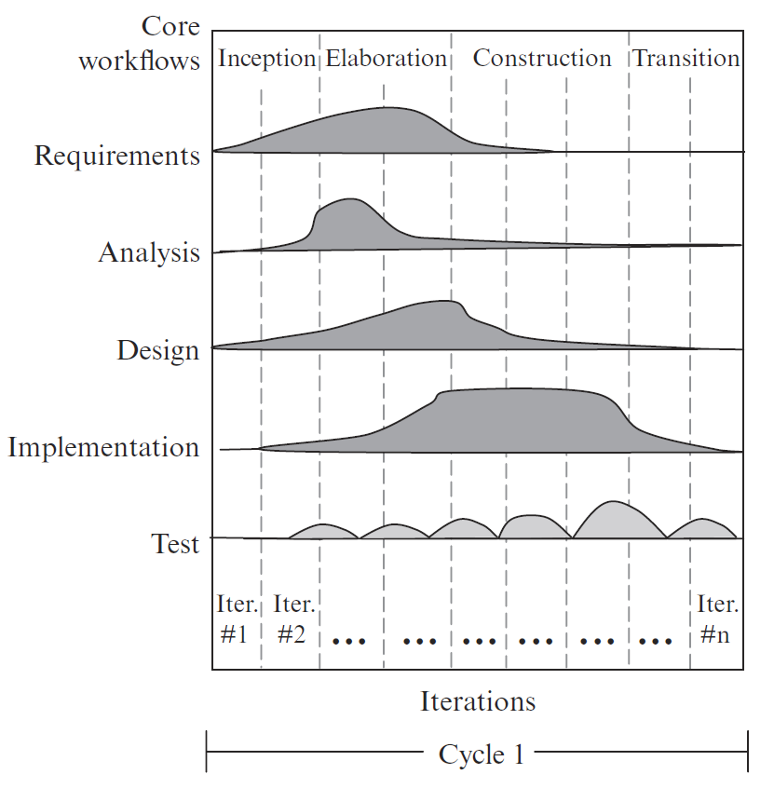
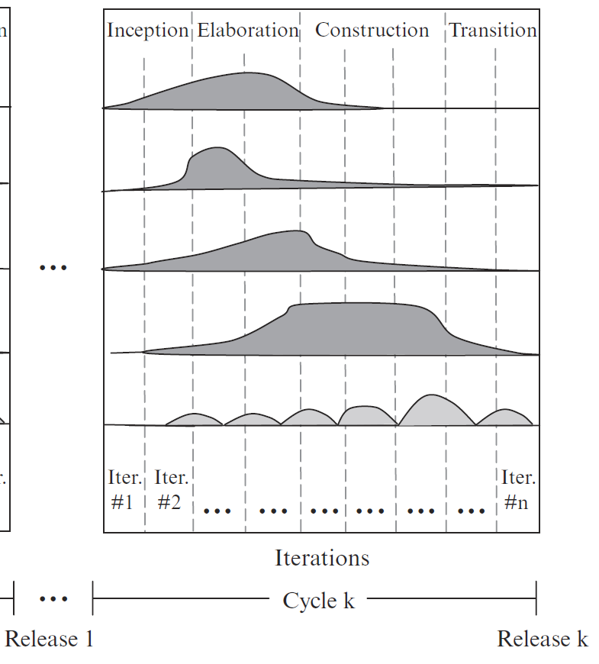
Rational Unified Process (RUP)
2-<number>

Slide 14
Rational Unified Process (RUP)
Inception consists of the first 1-2 iterations. It produces a simplified use case model, a tentative architecture, and a project plan.
Elaboration consists of the next N iterations. It produces the architectural design and implements the most critical use cases.
Construction, during which remaining use cases are iteratively implemented and integrated into the system.
Transition, during which the system is deployed, users are trained, and defects are corrected.
2-<number>

Slide 15
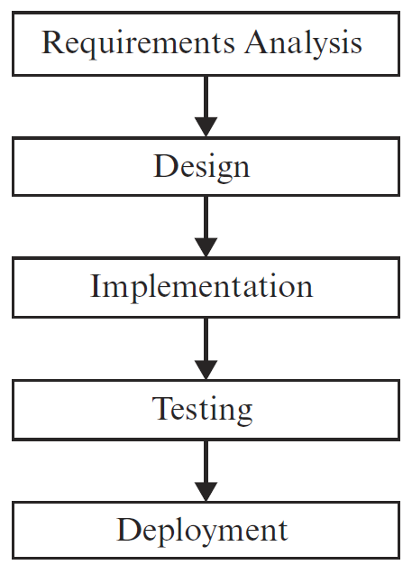
Agile Process Models
phases in an iteration
Iterations
2-<number>

Slide 16
Agile Methods and Attitudes
Stress agility – rapid and flexible response to change
The Agile Manifesto:
  Individuals and interactions over processes and tools
  Working software over comprehensive documentation
  Customer collaboration over contract negotiation
  Responding to change over following a plan
Any iterative process can be applied in the Agile spirit
2-<number>

Slide 17
The Agile Principles
Our highest priority is to satisfy the customer through early and continuous delivery of valuable software.
Welcome changing requirements, even late in development.
Deliver working software frequently, from a couple of weeks to a couple of months, with a preference to the shorter timescale.
Business people and developers must work together daily throughout the project.
Build projects around motivated individuals. Give them the environment and support they need, and trust them to get the job done.
The most efficient and effective method of conveying information to and within a development team is face-to-face conversation.
2-<number>

Slide 18
The Agile Principles
Working software is the primary measure of progress.
Agile processes promote sustainable development. The sponsors, developers, and users should be able to maintain a constant pace indefinitely.
Continuous attention to technical excellence and good design enhances agility.
Simplicity--the art of maximizing the amount of work not done--is essential.
The best architectures, requirements, and designs emerge from self-organizing teams.
At regular intervals, the team reflects on how to become more effective, then tunes and adjusts its behavior accordingly.
2-<number>

Slide 19
Agile Modeling
Models (UML drawings) help us to understand the project
  Not just documentation, or a blueprint to be handed to the software developer
Modeling is very important for Agile methods, and is a key tool for communication
Don’t “over-model”
  Not every class needs a UML drawing
  Some simpler or more obvious parts of the problem can be deferred until coding starts
  Apply modeling and UML drawing for the trickier or more complicated parts
Usually done at a whiteboard, with 2-4 people
2-<number>

Slide 20
Process and Methodology
Methodology is often confused with process.
A process is a set of inter-related activities to be carried out to construct something (usually a system).
The activities are carried out in phases.
Each phase produces some products which are the input of the next phase.
The completion of each phase establishes a milestone.
A methodology implements a process or a phase of a process.
2-<number>

Slide 21
Methodology
A methodology is a cook-book for performing a task. It describes
  steps to accomplish a series of subtasks
  input and output of each step
  representations of input and output
  entrance and exit conditions for each step
  procedures for carrying out each step
  methods and techniques used by each step
  relationships, or control flow and data flow between the steps
2-<number>

Slide 22
Process and Methodology
Process
Defines a framework of phased activities
Specifies phases of WHAT
Does not dictate representations of artifacts
It is paradigm-independent
A phase can be realized by different methodologies.
Examples
Waterfall, spiral, prototyping, unified, and agile processes
Methodology
Defines steps to carry out phases of a process
Describes steps of HOW
Defines representations of artifacts (e.g., UML)
It is paradigm-dependent
Steps describe procedures, techniques & guidelines
Examples
Structured analysis/structured
design (SA/SD), Object Modeling Technique (OMT), Scrum, DSDM, FDD, XP, and Crystal Orange
2-<number>

Slide 23
Software Paradigm
A software paradigm is a style of software development that constitutes a way of viewing the reality.
Examples:
  procedural paradigm
  OO paradigm, and
  data-oriented paradigm
2-<number>

Slide 24
Three Paradigms in History
Procedural paradigm views the world and system as:
  a network of processes
  a process is refined by lower level processes
  basic building blocks and starting point are processes
OO paradigm views the world and system as:
  interrelated and interacting objects
  basic building blocks are objects
Data-oriented paradigm views the world and system as:
  interrelated data entities, processed by transactions
  basic building blocks are data entities and relationships
2-<number>

Slide 25
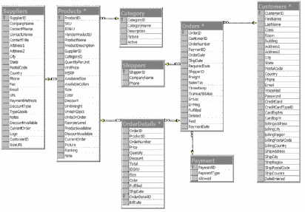
Paradigm and Methodology
Class - 1
Student
sn
attrib 1
sname
Books
attrib 2
orders
enroll
Customer
Process
invoices
Orders
Class - 2
Class - 3
(w/books)
credit status
attrib 1
attrib x
cn
attrib 2
Student
Customers
cname
Domain model
Structured Analysis
Object-Oriented Analysis
Data-Oriented Analysis
Top Manager
Obj
: class
b :
Bclass
A
Top Decider
m1 ( )
m2 ( )
m3 ( )
BE
CF
DG
info
m5 ( )
m4 ( )
B
E
C
F
D
G
m6 ( )
m7 ( )
m8 ( )
H
m10 ( )
m9 ( )
Structured Design
Sequence diagram
Object-Oriented Design
Data-Oriented Design
Structured Programming
Object-Oriented Programming
Programming in
4GL (e.g., SQL)
Procedural Paradigm
OO Paradigm
Data-Oriented Paradigm
2-<number>

Slide 26
Some Well-Known Agile Methods
Dynamic Systems Development Method (DSDM)
Feature Driven Development (FDD)
Scrum
Extreme Programming (XP)
…
2-<number>

Slide 27
DSDM Unique Key Features
It is a framework that works with Rational Unified Process and XP.
It is based on the 80-20 principle.
It is suitable for agile as well as plan-driven projects.
2-<number>

Slide 28
DSDM Lifecycle Activities
Feasibility Study
Business Study
Agree schedule
User approval & user guidelines
Create functional prototype
Identify functional prototype
Assess business impact
Functional model iteration
Implemen-tation
Train users
Review prototype
Deploy system
Review prototype
Identify design prototype
Create design prototype
Design & build iteration
Agree schedule
2-<number>

Slide 29
Feature Driven Development (FDD)
Unique key features:
  feature driven and model driven
  configuration management, review and inspection, and regular builds
  suitable for agile or plan-driven projects
2-<number>

Slide 30
FDD Lifecycle Activities
1.Develop
an Overall
Model
system walkthrough
develop group models
derive overall model from group models
produce model description
class diagram
2.Build a
Feature List
identify business activities to be automated
identify features of business activities
feature list
schedule development of activities
assign activities to chief
programmers
assign classes to team members
3.Plan By
Feature
schedule & assignments
produce sequence diagrams to show
object interaction using features
encapsulate features to form classes
structureal
& behavioral diagrams
4.Design
By Feature
implement the classes
Deployment
5.Build By
Feature
2-<number>

Slide 31
Scrum
Unique key features:
  include Scrum Master, Product Owner, and Team roles
  15 minute daily status meeting to improve communication
  team retrospect to improve process
2-<number>

Slide 32
Scrum Lifecycle Activities
Release planning meeting
  identify and prioritize requirements, called product backlog
  identify top priority requirements to be delivered within an increment, called a sprint
  identify sprint development activities
Sprint iteration
  sprint planning meeting to determine what and how to build next
  daily Scrum meeting to exchange status
Sprint review meeting
  increment demo
  team retrospection
Deployment
2-<number>

Slide 33


Scrum Process
Daily Scrum Meeting
Release Planning
Sprint Planning
2-4 Weeks
Sprint Retrospection
Potentially Shippable Product Increment
Product Backlog
Sprint Backlog
2-<number>

Slide 34
Extreme Programming (XP)
Unique Key Features:
  Anyone can change any code anywhere at any time
  Integration and build many times a day whenever a task is completed
  Work ≤ 40 hours a week
2-<number>

Slide 35
XP Lifecycle Activities
Exploration
1. Collect information about the application
2. Conduct feasibility study
Planning
1. Determine the stories for the next release
2. Plan for the next release
1. Define/modify architecture
2. Select and implement stories for each iteration
3. Perform functional tests by customer
Iteration to 1st Release
Productionizing
1. Evaluate and improve system performance
2. Certify and test system for production use
Maintenance
1. Improve the current release
2. Repeat process with each new release
Death
1. Produce system documentation if project
is done, or
2. Replace system if maintenance is too costly
2-<number>

Slide 36
The Methodology Presented in This Book
It is designed for beginners as well as seasoned developers.
It is aimed at educating software architects and systems analysts.
It can be applied to agile as well as plan-driven projects. It has been applied to sponsored as well as industrial projects.
Team members should work together from project start to completion.
Many students continue practicing the methodology after graduation.
2-<number>

Slide 37
Methodology Overview – Planning Phase
Business goals & needs
Current situation
Acquiring Requirements & Domain Modeling
Requirements
Deriving Use Cases
from Requirements
Abstract & high level use cases, use case diagrams
Allocating Use Cases &
to Iterations
Use case-iteration allocation matrix
Producing an
Architecture Design
Software architecture
2-<number>

Slide 38
Methodology Overview – Iterative Phase
Software architecture
Use case-iteration allocation matrix
Accommodating
Requirements Change
Iteration use cases
Domain Modeling
Domain model
Actor-System Interaction Modeling & UI Design
Domain model
Expanded use cases & UI design
Behavioral Design
Behavior diagrams
Deriving Design Class Diagram
Design class diagram
TDD, Integration, & Deployment
2-<number>

Slide 39
Example: The Dice Game
We will give an example of OOA/OOD for the following problem: We want to design an program that simulates a dice game. In the game, the player rolls two dice, and if the sum is seven, the player wins. Otherwise the player loses.
Step One: Define the Use Case.
  In this case, the use case is very simple, and can be stated as this:
    The Player plays the DiceGame. The DiceGame includes two Dice. The Player requests to roll the Dice. If the total of the two Dice is seven, the Player wins. Otherwise, the Player loses.
Step two: Define the Domain Model
  In this step, we describe the domain of the problem in terms of objects, and try to identify the associations between those objects
  We may add the noteworthy attributes of the objects
  Note that this is a conceptual model – not a design class diagram
2-<number>

Slide 40
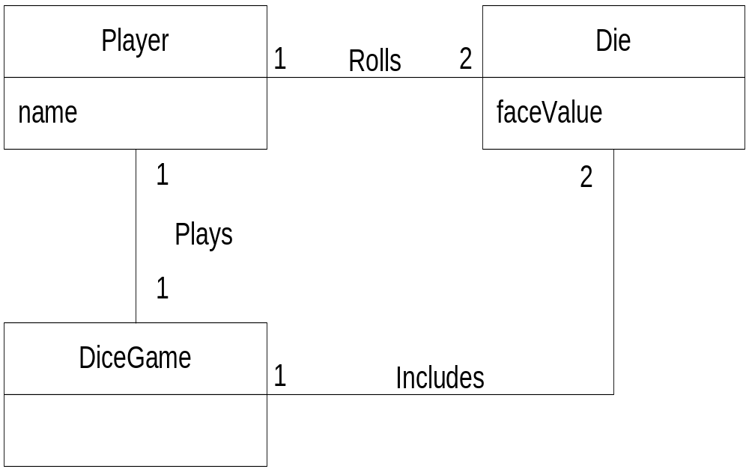
The Dice Game: Domain Model
2-<number>

Slide 41
The Dice Game: Object Responsibilities and Interactions
Step 3: We begin to define the software classes, and assign responsibilities
We can define “interaction diagrams” for software classes that will represent the objects we defined in Step 2
Note that at this step, we begin to deal with the real software classes (more specifically, instances of the real classes).
These will be based upon, but may not exactly match up with, the domain concepts or objects we identified in Step 2.
For example, there is no class for Player, since this is not part of the app we are developing
2-<number>

Slide 42
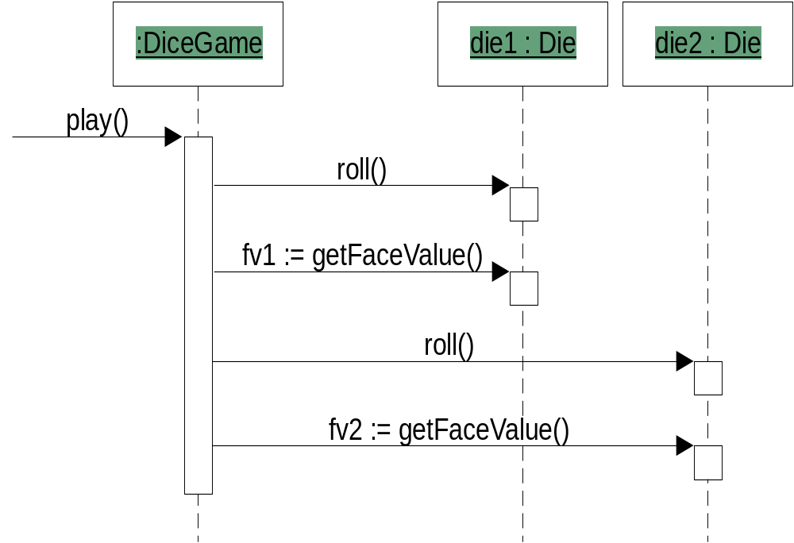
The Dice Game: Interaction Diagram
2-<number>

Slide 43
The Dice Game: Design Class Diagrams
Step 4: We are now ready to design the class diagrams
Using the interaction diagrams, we can define the classes, their attributes, and methods
Note: This is not coding. We do not specify how the methods will work, and we may not specify every attribute of the class.
We want to define the important methods and attributes that are needed to make the system work, so that a developer can take this model and build code from it
2-<number>

Slide 44
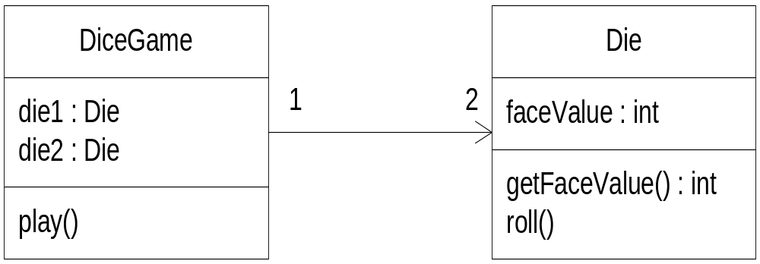
The Dice Game: Class Design Diagram
2-<number>

Slide 45
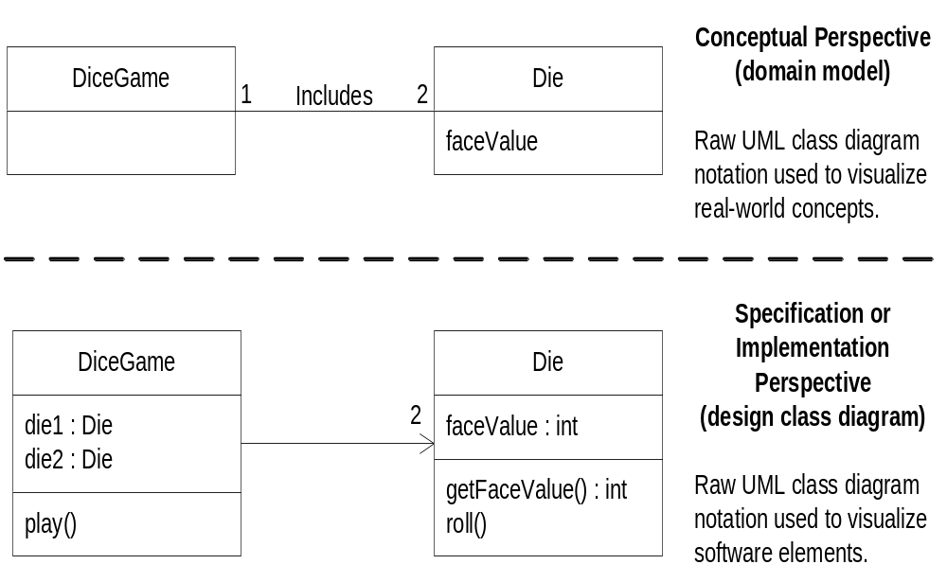
UML: Conceptual versus Specification Perspective
2-<number>

